Slide 1
CS2422 Assembly Language & System Programming
December 23, 2003

Slide 2
Today’s Topics
Machine-Independent Macro Processor Features
  Concatenation of macro parameters
  Generation of unique labels
  Conditional macro expansion
  Keyword macro parameters
Macro Processor Design Options
  Recursive macro expansion
  Macro processing within language translators

Slide 3
Study Guide
Section 4.2
Section 4.3

Slide 4
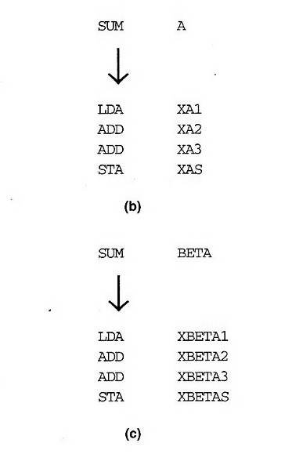
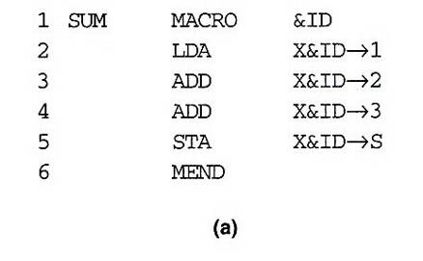
Concatenation of Macro Parameters
Pre-concatenation
  LDA X&ID1
Post-concatenation
  LDA X&ID→1
Example: Fig. 4.6

Slide 5
Generation of Unique Labels
Example
  JEQ *-3
  inconvenient, error-prone, difficult to read
Example Fig. 4.7
    $LOOP TD =X’&INDEV’
  1st call:
    $AALOOP TD =X’F1’
  2nd call:
    $ABLOOP TD =X’F1’

Slide 6
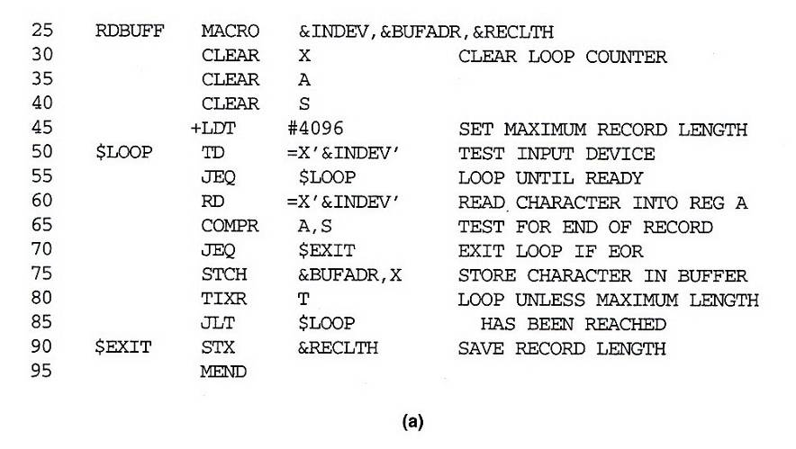
Fig. 4.7(a)

Slide 7
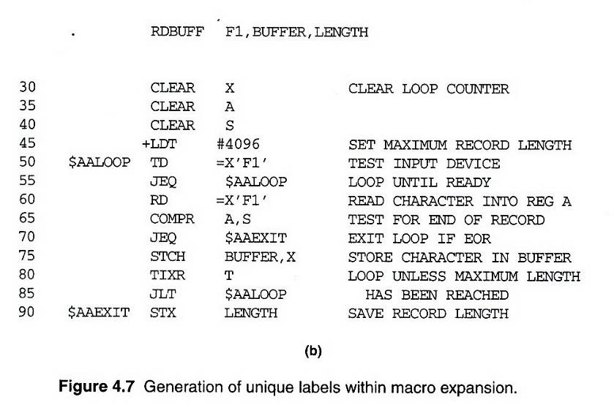
Fig. 4.7(b)

Slide 8
Conditional Macro Expansion (1/2)
Macro-time conditional statements
  Example: Fig. 4.8
  IF-ELSE-ENDIF
Macro-time variables
  Any symbol that begins with the character & and that is not a macro parameter
  Macro-time variables are initialized to 0
  Macro-time variables can be changed with their values using SET
    &EORCK SET 1

Slide 9
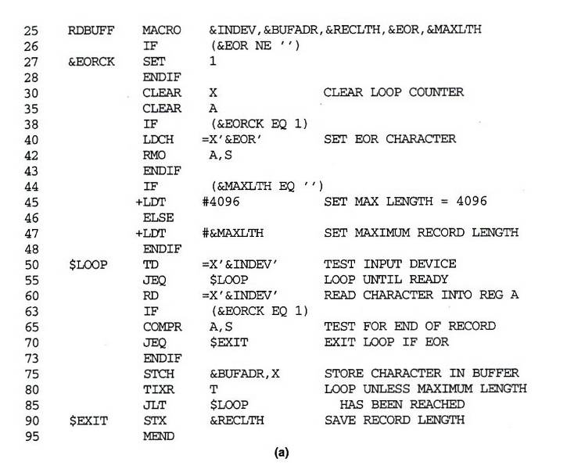
Fig. 4.8(a)

Slide 10
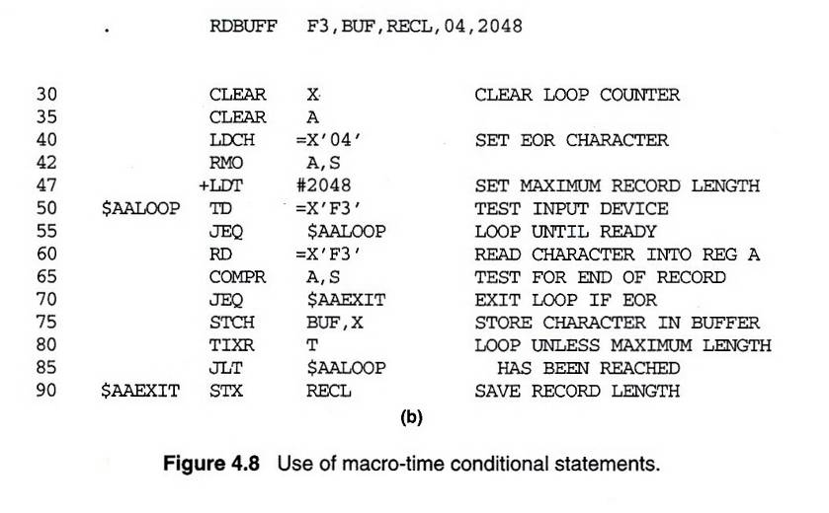
Fig. 4.8(b)

Slide 11
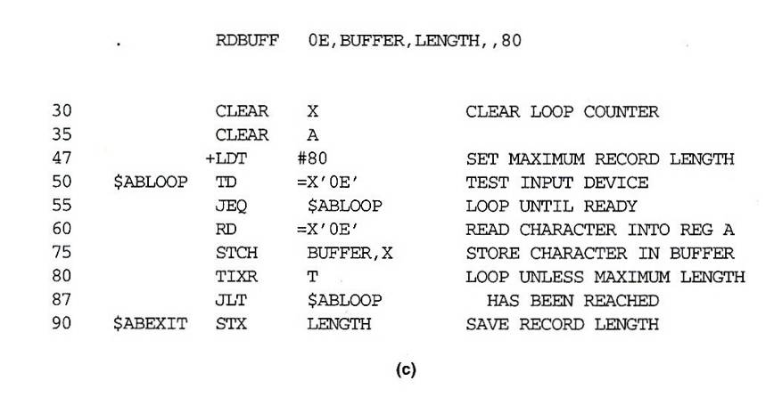
Fig. 4.8(c)

Slide 12
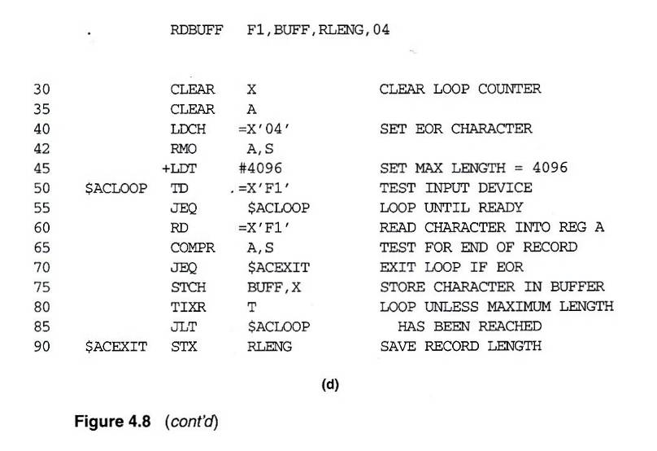
Fig. 4.8(d)

Slide 13
Conditional Macro Expansion (2/2)
Macro-time looping statement
  Example: Fig. 4.9
  WHILE-ENDW
Macro processor function
  %NITEMS: The number of members in an argument list

Slide 14
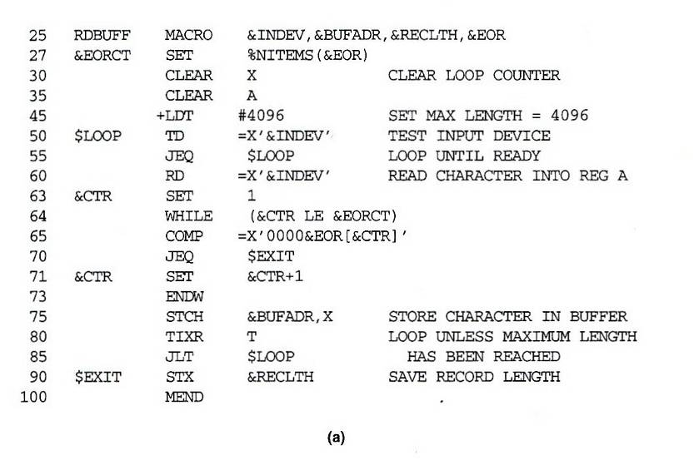
Fig. 4.9(a)

Slide 15
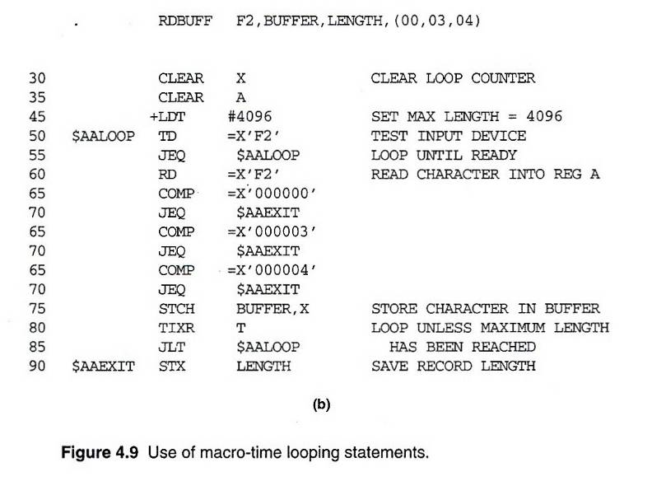
Fig. 4.9(b)

Slide 16
Keyword Macro Parameters (1/2)
Positional parameters
  Parameters and arguments were associated with each other according to their positions in the macro prototype and the macro invocation statement
  Consecutive commas is necessary for a null argument
    GENER ,,DIRECT,,,,,,3

Slide 17
Keyword Macro Parameters (2/2)
Keyword parameters
  Each argument value is written with a keyword that names the corresponding parameter
  A macro may have a large number of parameters , and only a few of these are given values in a typical invocation
    GENER TYPE=DIRECT, CHANNEL=3
  See Fig. 4.10

Slide 18
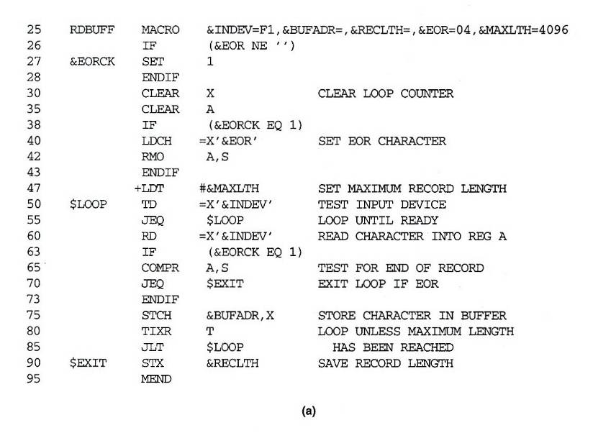
Fig. 10(a)

Slide 19
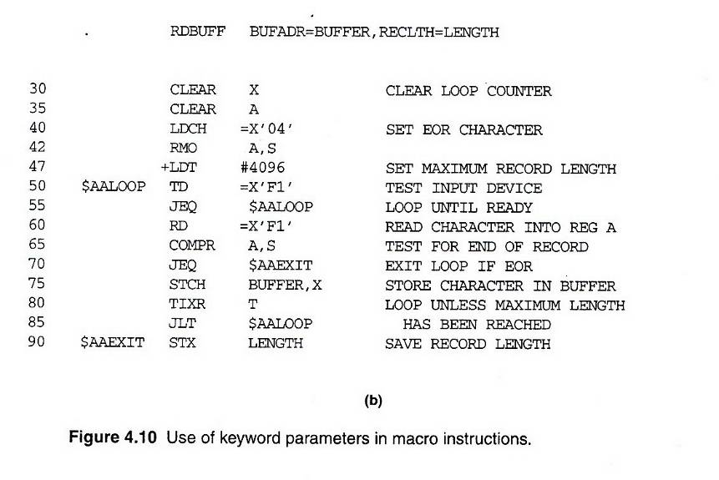
Fig. 10(b)

Slide 20
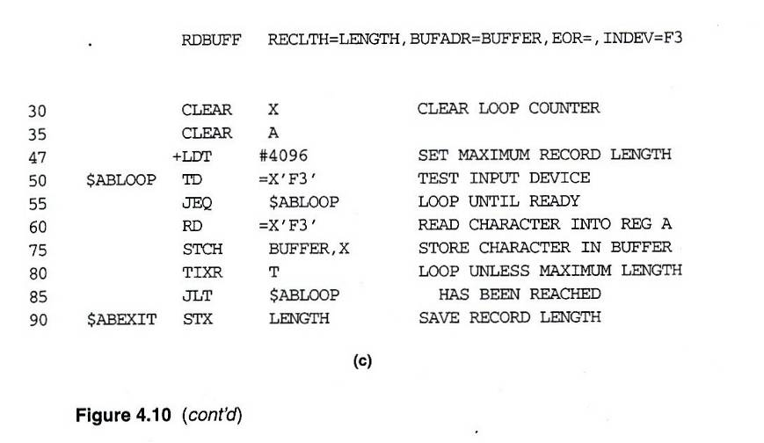
Fig. 10(c)

Slide 21
Nested Macro Invocations
Macro invocations within macros
  Process macro invocation during expansion time
Recursive macro expansion
  Example: Fig. 4.11
  Problems:
    ARGTAB
    EXPANDING
  Solution
    Recursive call (programming language supports)
    While loop with stack

Slide 22
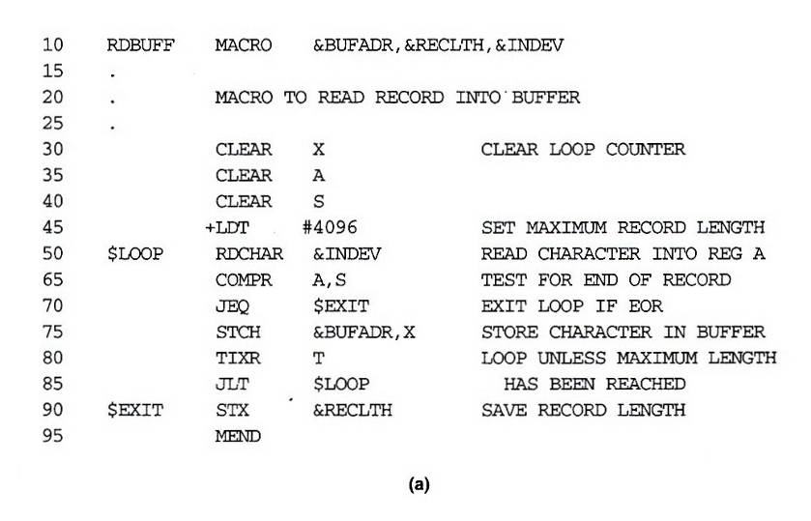
Fig. 4.11(a)

Slide 23
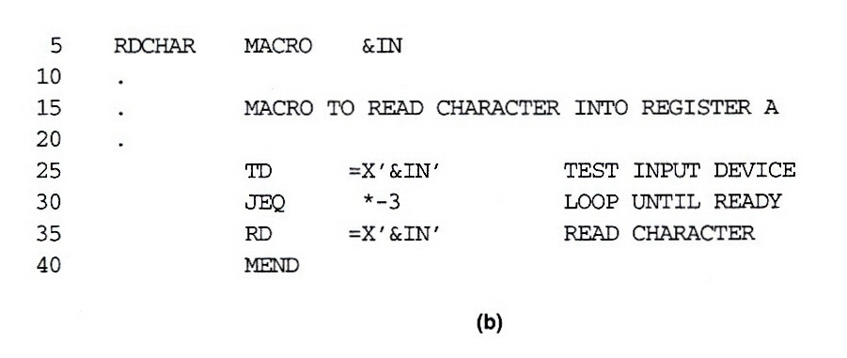
Fig. 4.11(b)

Slide 24
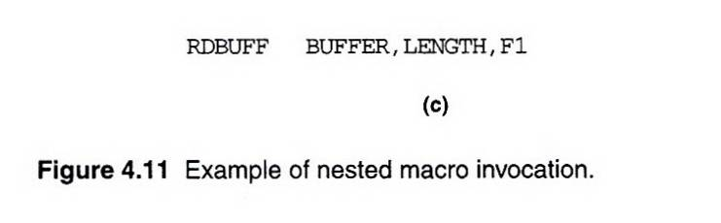
Fig. 4.11(c)
Parameter Value
---------------------------------
1 BUFFER
2 LENGTH
3 F1
4 (unused)
. .
---------------------------------
Parameter Value
---------------------------------
1 F1
2 (unused)
. .
---------------------------------

Slide 25
General-Purpose Macro Processors (1/6)
Macro processors have been developed for some high-level programming languages
These special-purpose macro processors are similar in general function and approach; however, the details differ from language to language

Slide 26
General-Purpose Macro Processors (2/6)
The advantages of such a general-purpose approach to macro processing are obvious
  The programmer does not need to learn about a different macro facility for each compiler or assembler language, so much of the time and expense involved in training are eliminated
  A substantial overall saving in software development cost

Slide 27
General-Purpose Macro Processors (3/6)
In spite of the advantages noted, there are still relatively few general-purpose macro processors. Why?
  In a typical programming language, there are several situations in which normal macro parameter substitution should no occur
    E.g. comments should usually be ignored by a macro processor

Slide 28
General-Purpose Macro Processors (4/6)
  Another difference between programming languages is related to their facilities for grouping together terms, expressions, or statements
    E.g. Some languages use keywords such as begin and end for grouping statements. Others use special characters such as { and }.

Slide 29
General-Purpose Macro Processors (5/6)
  A more general problem involves the okens of the programming language
    E.g. identifiers, constants, operators, and keywords
    E.g. blanks

Slide 30
General-Purpose Macro Processors (6/6)
  Another potential problem with general-purpose macro processors involves the syntax used for macro definitions and macro invocation statements. With most special-purpose macro processors, macro invocations are very similar in form to statements in the source programming language

